Slide 1

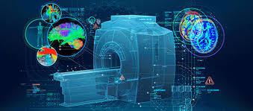
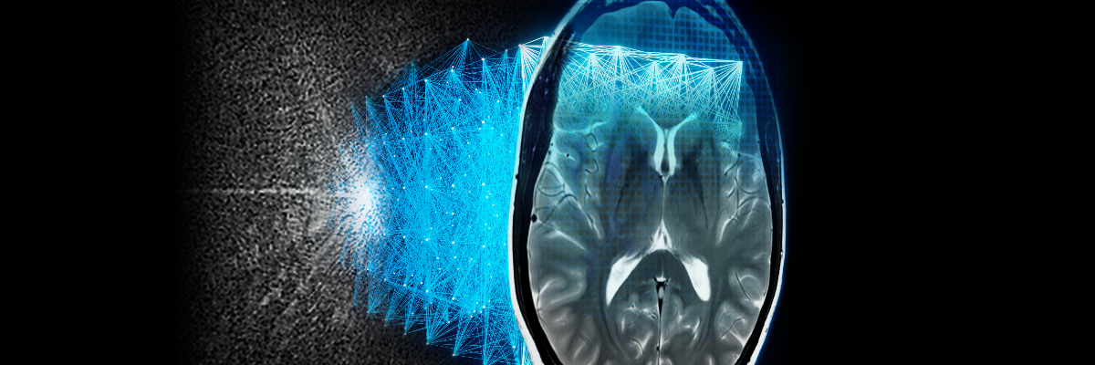
Probabilistic Model for Brain MRI Segmentation

Slide 2
Introduction
The brain and spinal column make up the central nervous system (CNS).
The brain tumor is abnormal growth of the cells in the brain, can be benign or malignant.
Benign tumors grow slowly and do not typically spread.
Malignant tumors grow much more rapidly than benign tumors.
Primary brain tumors -Brain tumors that start as a growth of cells in the brain itself.
Secondary brain tumors - a cancerous tumor that started in another part of the body, such as the breast, lung, or colon, and then spread to the brain.
Symptoms - Vary depend on parts of the brain affected like Headache, Nausea, vomiting, Sensor disturbance, Speech difficulty and Hearing difficulty.

Slide 3
Diagnosing System
Neurological Exam: Checks vision, hearing, balance, coordination, strength, reflexes to assess brain function.
Brain or Spinal Tap/Lumbar Puncture: In certain cases, the doctor might remove a sample of cerebrospinal fluid to check for cancer cells.
Biopsy: Removes tissue to analyze tumor type & grade. Can be done separately or during surgery.
Molecular Testing: Examines the tumor's genetic makeup, providing information about specific mutations in the tumor cells that might guide treatment options.
Imaging Tests: MRI most common brain tumor test, dye injected to visualize. CT, PET, angiogram may also be used.

Slide 4
Computer Aided Diagnosing System
Computer-Aided Diagnosis (CAD)
Computer simulation and image processing techniques are being used to improve brain tumor detection and diagnosis.
CAD systems can boost diagnostic accuracy but are not a replacement for doctors.
Combination of feature extraction techniques and deep learning to extract more detailed information.
CNNs can automatically extract features without manual feature extraction.
U-Net is a powerful model for medical image segmentation, but choosing the optimal topology is challenging.

Slide 5
Significance of Brain Tumor Segmentation(BTS)
Accurate Diagnosis: Segmentation localizes and outlines tumors, crucial for accurate diagnosis and understanding
Treatment Planning: Effective segmentation guides treatment planning, helping surgeons visualize and safely remove tumors
Radiation Therapy Planning: Accurate tumor segmentation ensures that the maximum dose of radiation is delivered to the tumor
Tracking Progression: Progression of the tumor over time, providing insight into the effectiveness of the treatment and informing adjustments to the treatment plan
Research and Training: Develop and test new treatment modalities, and in education to train future radiologists and neurosurgeons
Personalized Medicine: Accurate segmentation is a crucial step towards personalized medicine, where treatments are tailored to the individual patient's specific tumor characteristics

Slide 6
Literature Survey
S.No | Title | Author | Methodology | Remarks
1 | Segmentation and analysis emphasizing neonatal MRI brain images using machine learning techniques | Saladi et al. (2023) | Combination of 5 ML algorithm | Assumes that the data is linearly correlated, which may not hold in some cases.
2 | The 2021 WHO classification of tumors of the central nervous system: a summary | Louis et al. (2021) | KNN, PCA, SVM, Random forest | Models trained on biased data can perpetuate existing biases and inequalities
3 | Overview of multi-modal brain tumor mr image segmentation. | Zhang et al. (2021) | KNN, SVM, Random forest, Dictionary Learning | High Computational complexity for high resolution image
4 | Enhanced region growing for brain tumor MR image segmentation | Biratu et al. (2021) | Region-based segmentation | Reduced performance, when data is not linearly separable.
5 | Brain tumor detection in MR image using superpixels, principal component analysis and template based K-means clustering algorithm | Islam et al. (2021) | TK algorithm, PCA | Not suitable for feature selection; reduces feature dimensionality never provide feature importance rankings.
6 | Brain tumor detection using image segmentation techniques | Reddy et al. (2018) | K means | High Computationally expensive during inference for large datasets

Slide 7
Literature Survey (Cont..)
S.No | Title | Author | Methodology | Remarks
7 | Brain tumor segmentation based on a new threshold approach | Ilhan and Ilhan (2017) | Graph-Based Segmentation | The model provide wrong boundaries in case of inhomogeneity’s
8 | Brainseg-net: Brain tumor mr image segmentation via enhanced encoder–decoder network | Rehman et al. (2021) | SegNet | Prone to overfitting due to a large number of parameters.
9 | A novel deep learning model DDU-net using edge features to enhance brain tumor segmentation on MR images. | Jiang et al. (2021) | DDU-Net | Difficulty in handling anatomical variations between patients
10 | Computer-aided brain tumor diagnosis: performance evaluation of deep learner CNN using augmented brain MRI. | Naseer et al. (2021) | CNN | Suboptimal performance, when segmenting small structures.
11 | Deep learning approach for brain tumor detection and segmentation | Raut et al. (2020) | Mask R CNN | Resource-intensive during training and inference.
12 | A novel end-to-end brain tumor segmentation method using improved fully convolutional networks. | Li et al. (2019) | FCNN | Vulnerable to issues with small training datasets.

Slide 8
Problem Statement
Limited availability of brain MR image is a challenging for deep neural networks.
Small size of tumor region are never segmented due to overfitting in deep learning models.
High-resolution MR image lead to high time complexity and computational complexity in deep learning model.
The “black box” nature of neural networks leads to low interpretability by clinician.
Manual annotations is used as ground truth Inter and Intra-rater variability, which leads to inconsistencies during the training
MR brain images are prone to physical and motion artifacts during image acquisition, which leads to overfitting in the deep learning models

Slide 9
Objective
• To propose an efficient deep learning method for brain tumor segmentation using MR Images, which effectively identifies different types of brain tumors.
• To design a Model capable of improving the performance of segmentation of tumor in heterogeneous tissue region.

Slide 10
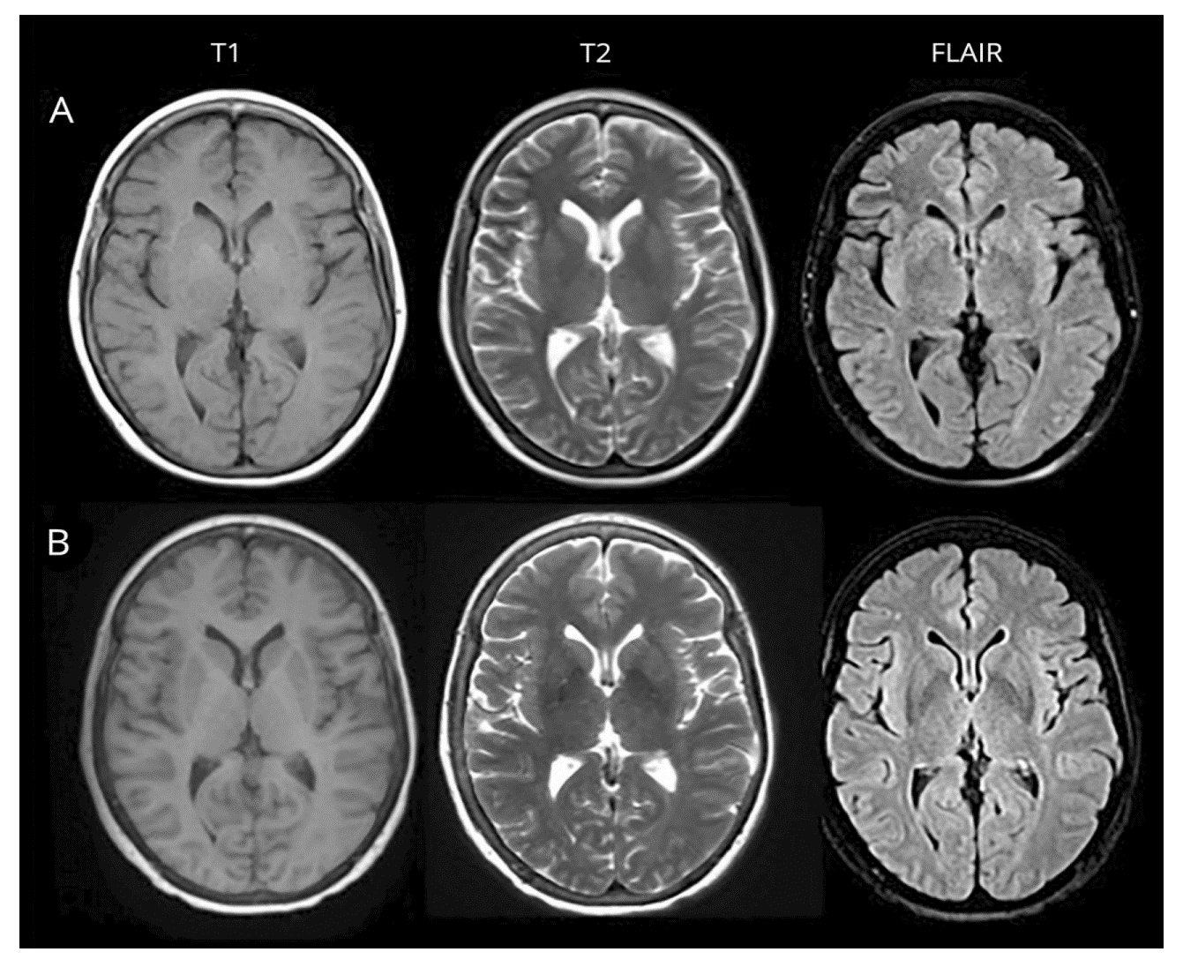
Datasets
TCIA data set was used.
The TCIA brain tumor dataset with skull is a collection of pre-operative and post-operative multimodal MR images of various brain tumor types

Slide 11
Proposed model
The proposed word of the process of identification and classification of the brain tumor image is of three folds.
In order to mention it in the sequential order, the probabilistic U-Net is being employed in the image segmentation process and feature extraction.
The process flow of the research work which is being proposed, defining the tri-fold process of detecting and classifying the brain tumor.

Slide 12
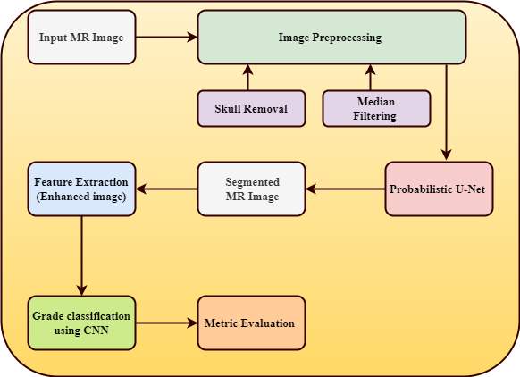
Proposed model

Slide 13
Image Pre- processing-Skull Removal
Image thresholding to deconstruct mental clutter.
Filling in the blanks with morphological operators for extracted objects.
Morphological operations include dilation, erosion, opening, and closing.
Finding edges and potentially refining them using edge detection.
Constructing a binary mask by selecting the image's biggest region.
Producing a new image by fusing the input image with the binary mask.

Slide 14
Image Pre- processing-Filtering
Median filtering is employed iteratively to mitigate various noise types such as Gaussian, random, and salt and pepper noise, ensuring a clearer representation of brain structures.
Median filtering replaces each pixel with the median of its neighboring entries, effectively reducing high-frequency components associated with noise, while preserving important image features.
Enhanced Segmentation and Classification: Filtered MR images serve as the foundation for segmentation and classification tasks, improving the accuracy and reliability of subsequent analyses, leading to better insights into neurodegenerative diseases and neurological disorders.

Slide 15
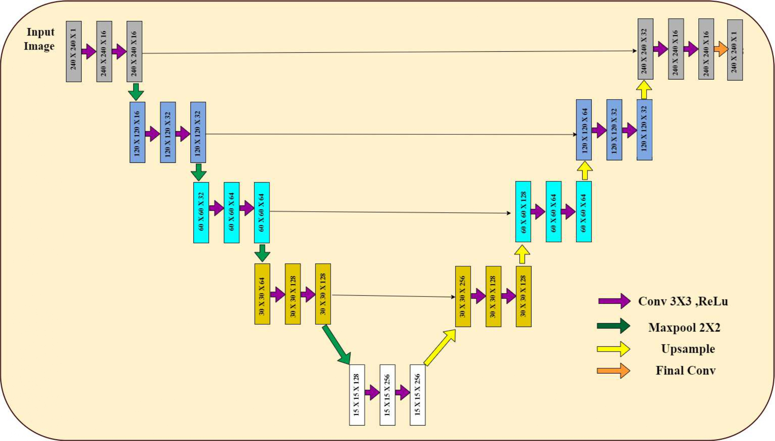
U-Net

Slide 16
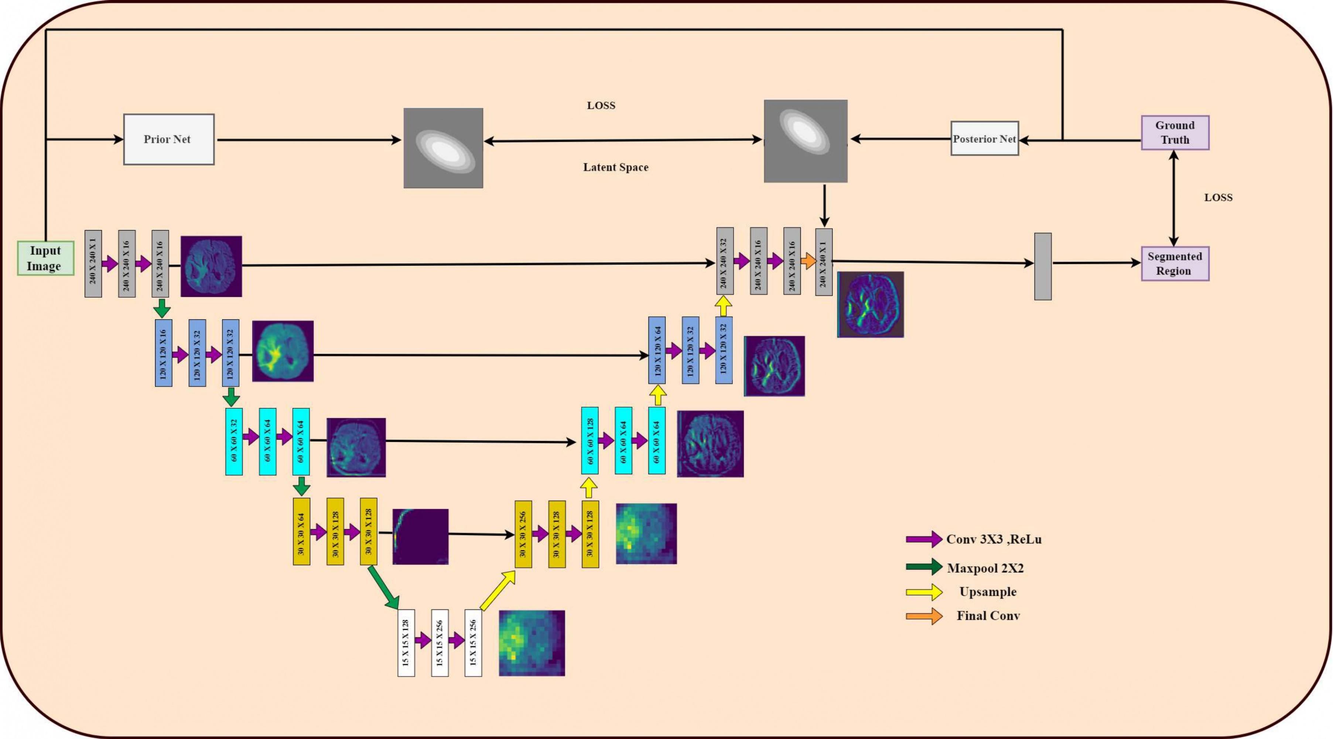
Probabilistic U-Net

Slide 17
Probabilistic U-Net
Integrates the capabilities of a standard U-Net with a conditional variational autoencoder (cVAE).
U-Net's structure captures spatial hierarchies and intricate patterns in the image, the cVAE is trained to model the distribution of possible segmentations conditioned on the input.
Captures uncertainty in medical images due to noise, ambiguities, and device variations, aiding risk-assessment and decision-making.
Latent Variable: Represents aleatoric uncertainty.
Prior & Posterior Networks: Predict latent distributions.
Inference: Uses encoder output and prior's latent sample
Combined segmentation loss + KL-divergence reduces overfitting and ensures meaningful uncertainty in scarce medical data scenarios.

Slide 18
CNN for Brain Tumor Classification
CNN is the most widely used supervised AI image classification technique. To extort the different levels of features in the MRI image, this work employs convolutional layers.
The activation function is used to clip any negative values that the convolution operation might occasionally produce below zero to one, which causes nonlinearity in the model.
The proposed CNN model possess the pooling layers which are employed to generate a statistical summary based on the input function and deduce dimensionally without ignoring significant input functions.
The proposed AI based CNN model is trained and tested on a TCIA dataset encompassing the brain tumor MR images.
This approach leverages the power of AI to assist medical professionals in accurately and efficiently diagnosing brain tumors, enabling early detection and improved patient outcomes.

Slide 19
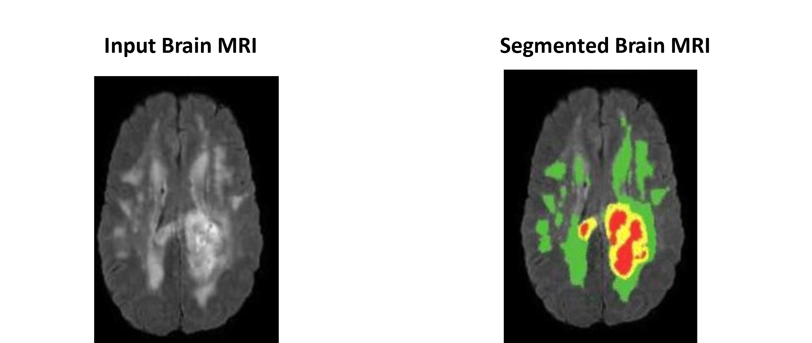
Sample Segmented Images

Slide 20
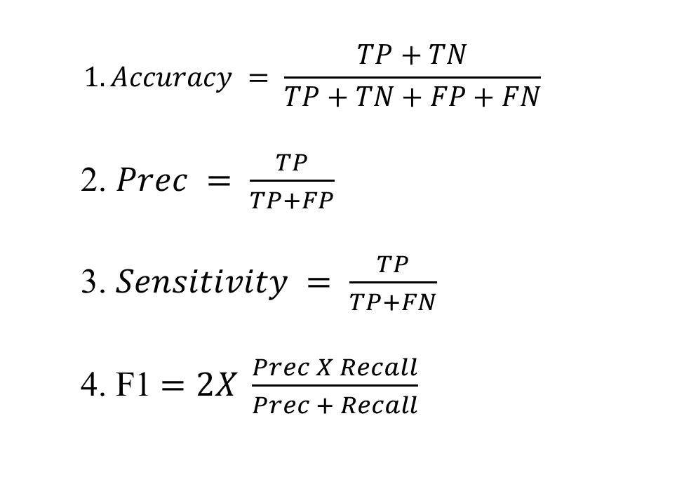
Evaluation Metrics
$$1.Accuracy = \frac{TP+TN}{TP+TN+FP+FN}$$
2. $Prec = \frac{TP}{TP+FP}$
3. $Sensitivity = \frac{TP}{TP+FN}$
4. F1$=2X \frac{Prec X Recall}{Prec + Recall}$

Slide 21
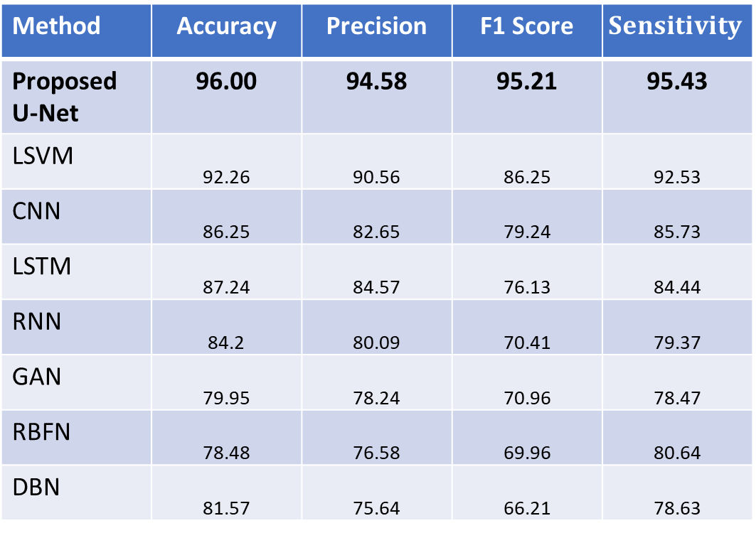
Performance Evaluation TCIA Dataset
Method | Accuracy | Precision | F1 Score | $$Sensitivity$$
Proposed U-Net | 96.00 | 94.58 | 95.21 | 95.43
LSVM | 92.26 | 90.56 | 86.25 | 92.53
CNN | 86.25 | 82.65 | 79.24 | 85.73
LSTM | 87.24 | 84.57 | 76.13 | 84.44
RNN | 84.2 | 80.09 | 70.41 | 79.37
GAN | 79.95 | 78.24 | 70.96 | 78.47
RBFN | 78.48 | 76.58 | 69.96 | 80.64
DBN | 81.57 | 75.64 | 66.21 | 78.63

Slide 22
Conclusion
The use of AI in the prediction and classification of brain tumors can improve the accuracy of diagnosis and treatment.
This study showed that a combination of Probabilistic U-Net algorithms can achieve an better accuracy .
This study was conducted on the TCIA dataset, and the results suggest that the proposed approach can be extended to other datasets and algorithms for further improvement

Slide 23
REFERENCES
[1] Pei L, Vidyaratne L, Rahman MM, Iftekharuddin KM. Context aware deep learning for brain tumor segmentation, subtype classification, and survival prediction using radiology images. Scientific Reports. 2020 Nov 12;10(1):1-1.
[2] Yaqub M, Feng J, Zia MS, Arshid K, Jia K, Rehman ZU, Mehmood A. State-of-the-art CNN optimizer for brain tumor segmentation in magnetic resonance images. Brain Sciences. 2020 Jul 3;10(7):427.
[3] Karuppusamy P. Hybrid manta ray foraging optimization for novel brain tumor detection. Journal of Soft Computing Paradigm (JSCP). 2020 Jul 23;2(03):175-85.
[4] Murthy MY, Koteswararao A, Babu MS. Adaptive fuzzy deformable fusion and optimized CNN with ensemble classification for automated brain tumor diagnosis. Biomedical engineering letters. 2022 Feb;12(1):37-58.
[5] Muhammad K, Khan S, Del Ser J, De Albuquerque VH. Deep learning for multigrade brain tumor classification in smart healthcare systems: A prospective survey. IEEE Transactions on Neural Networks and Learning Systems. 2020 Jun 30;32(2):507-22.
[6] Raja PS. Brain tumor classification using a hybrid deep autoencoder with Bayesian fuzzy clustering-based segmentation approach. Biocybernetics and Biomedical Engineering. 2020 Jan 1;40(1):440-53.
[7] Yang T, Song J, Li L. A deep learning model integrating SK-TPCNN and random forests for brain tumor segmentation in MRI. Biocybernetics and Biomedical Engineering. 2019 Jul 1;39(3):613-23.
[8] Das S, Bose S, Nayak GK, Satapathy SC, Saxena S. Brain tumor segmentation and overall survival period prediction in glioblastoma multiforme using radiomic features. Concurrency and Computation: Practice and Experience. 2022 Sep 10;34(20):e6501.
[9] Deng W, Shi Q, Wang M, Zheng B, Ning N. Deep learning-based HCNN and CRF-RRNN model for brain tumor segmentation. IEEE Access. 2020 Jan 15;8:26665-75.
[10] Narmatha C, Eljack SM, Tuka AA, Manimurugan S, Mustafa M. A hybrid fuzzy brain-storm optimization algorithm for the classification of brain tumor MRI images. Journal of ambient intelligence and humanized computing. 2020 Aug 14:1-9.

Slide 24

Thank You

